Slide 1

DIALY CLIMATE TIME SERIES DATA
TEAM 7
Rounak de
Rushikethan reddy Dudipala
Vamsi krishna Malempati
Vinay reddy Poreddy
Satish kumar MNV

Slide 2
Agenda
Introduction
Problem Statement
Data Description
Data Analysis
Modelling
Model Comparison
Results
Insights and Recommendation

Slide 3

Introduction
We are predicting the weather of the city- New Delhi, the capital of India New Delhi typically experience around 4 season in a year
Although, these seasons are predictable each year, predicting the weather conditions of New Delhi is not a piece of cake
The summers in Delhi are extremely hot and winters are extremely cold
Delhi temperatures can vary between -2.2 C(lowest) to 48.4 C(highest)

Slide 4
Problem Statement
Weather forecasts have an impact on many lives and help people make well-informed decisions, from individuals planning outdoor activities, choosing what to wear, and preparing for potential hazards like black ice and fog, to industries like agriculture planning their activities like fertilizing and harvesting around weather conditions.
The main objective is forecasting the climate Temperature for Delhi by performing time series forecasting on the past data.
Weather forecasting is important because it enables people and organizations to organize their activities and operations in accordance with the weather conditions that will prevail.

Slide 5
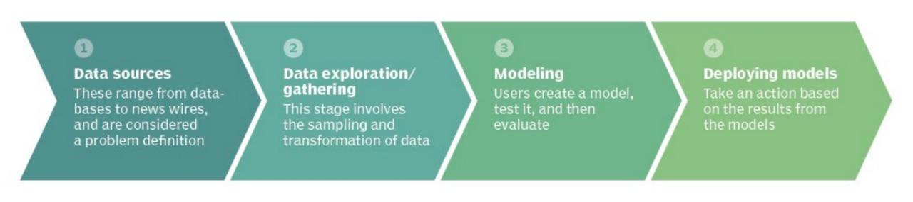
Our Approach

Slide 6
What did we perform
Obtain the dataset which is best suitable for our prediction
Process the dataset with EDA after it ready for model building
Analysis of the parameters which influence the weather conditions using data-mining
Prediction of the unforeseen Delhi’s weather condition for the next 3-6 months
Determine which season’s temperature and humidity has the most influence
Provide our insights and recommendations based on our prediction

Slide 7
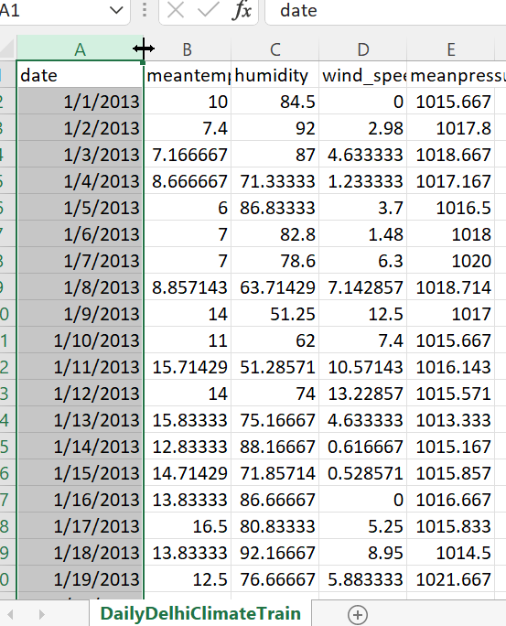
Data Description
Sourced from Kaggle
Dataset contain data from 2013 to 2016
Parameters: mean temp, humidity,
wind_speed and mean pressure

Slide 8
Data Dictionary
Date
Meantemp
Humidity
Wind_Speed
Meanpressure

Slide 9
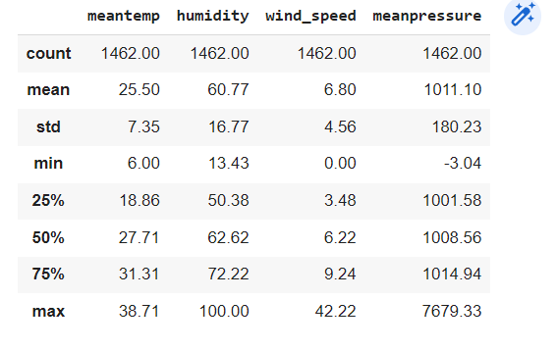
Data Summary
The overall summary of the data available.

Slide 10
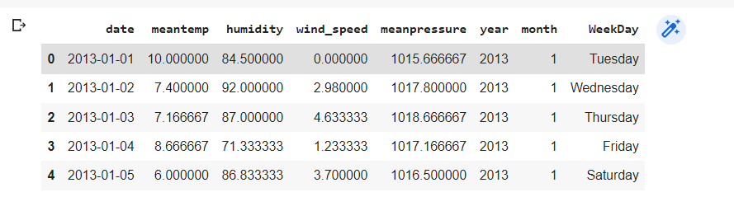
Data Preprocessing
Observed no null values
Added additional columns Weekdays
Months
Season

Slide 11
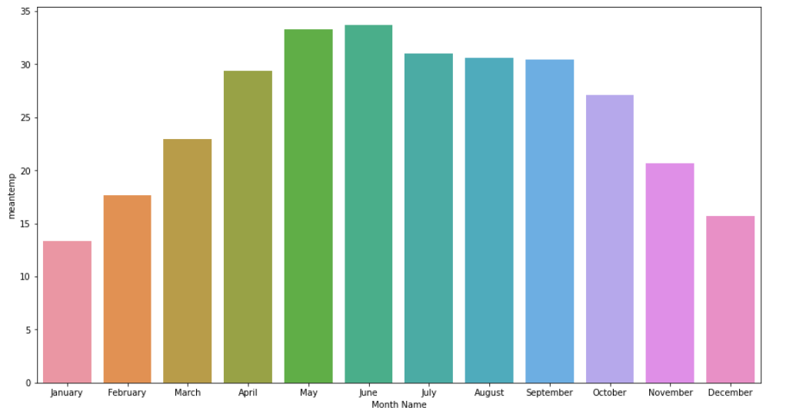
Seasons with months

Slide 12
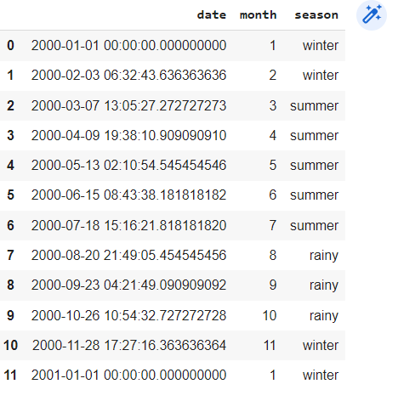
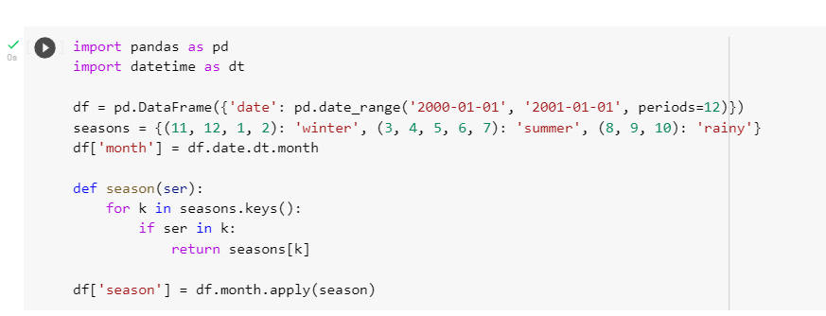
Seasons and Variations

Slide 13
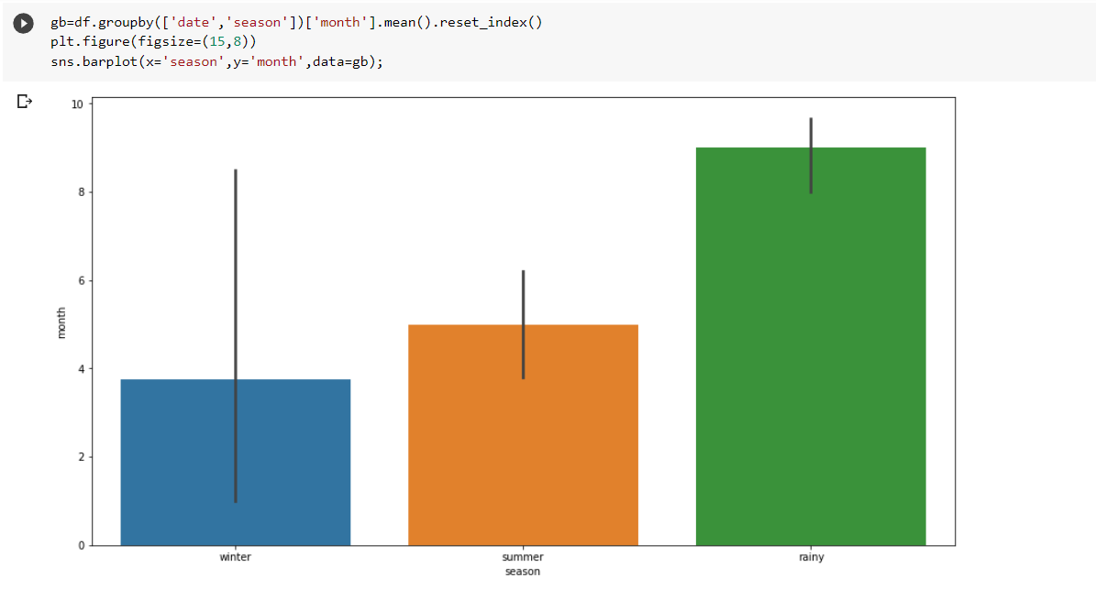
Seasons and Variations

Slide 14
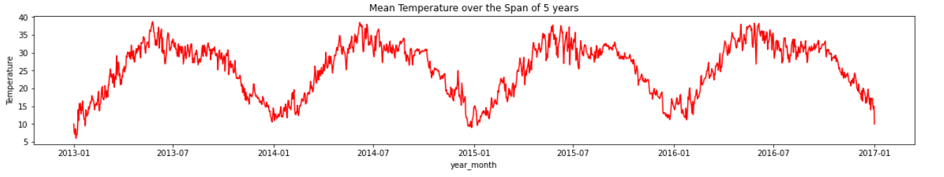
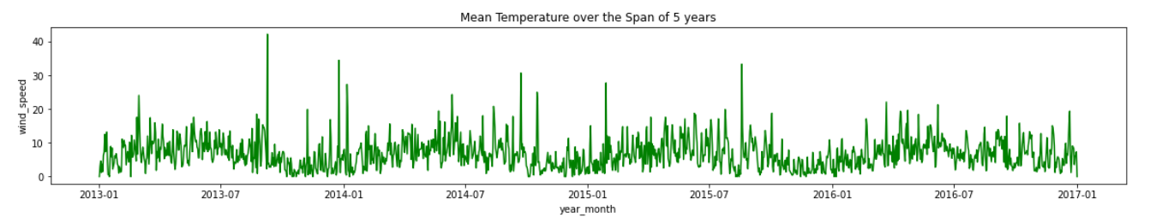
EDA-1

Slide 15
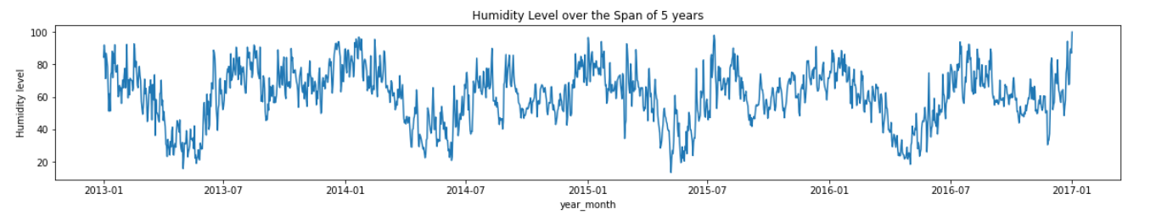
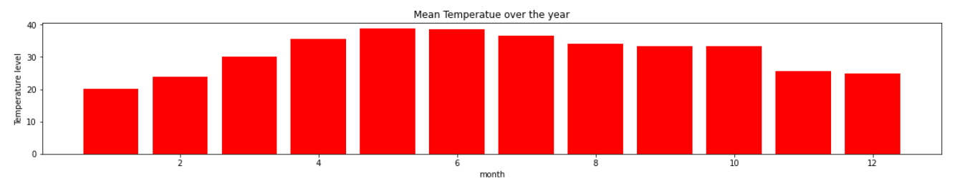
EDA - 2

Slide 16
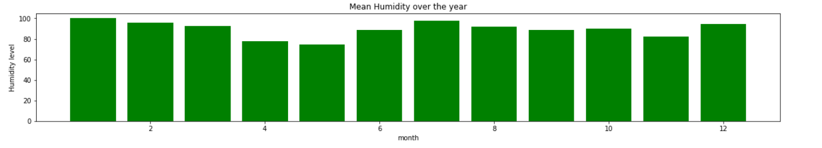
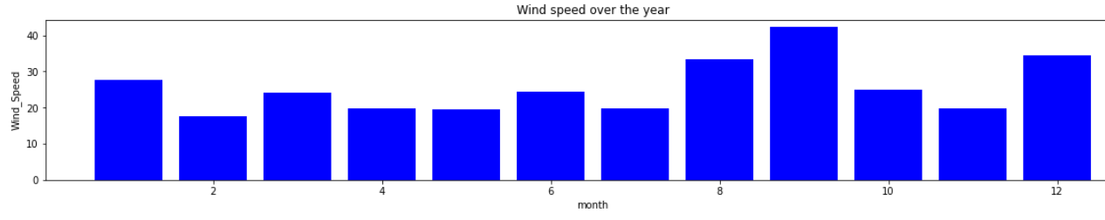
Visualizations

Slide 17
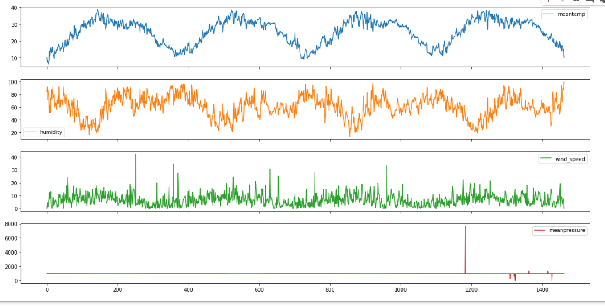
Visualizations
Comparison between temperature with humidity, windspeed and meantemp respectively

Slide 18
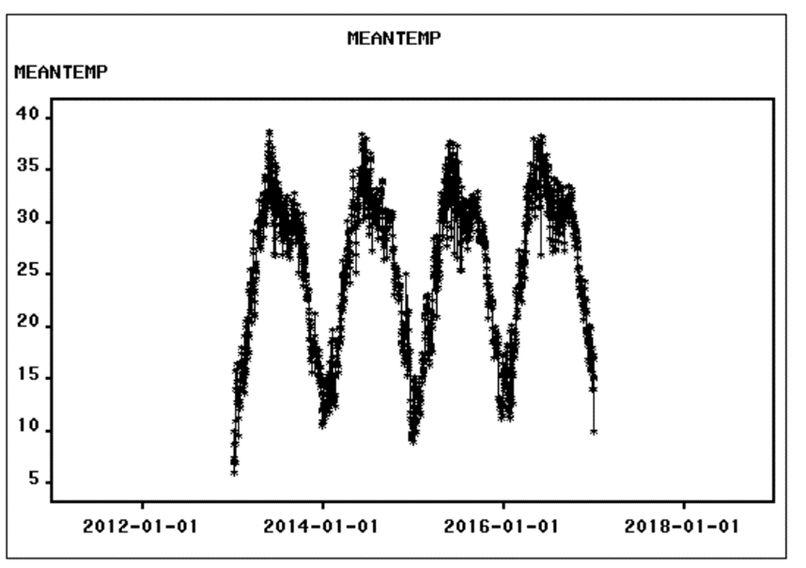
Seasonality
No particular seasonality is observed

Slide 19
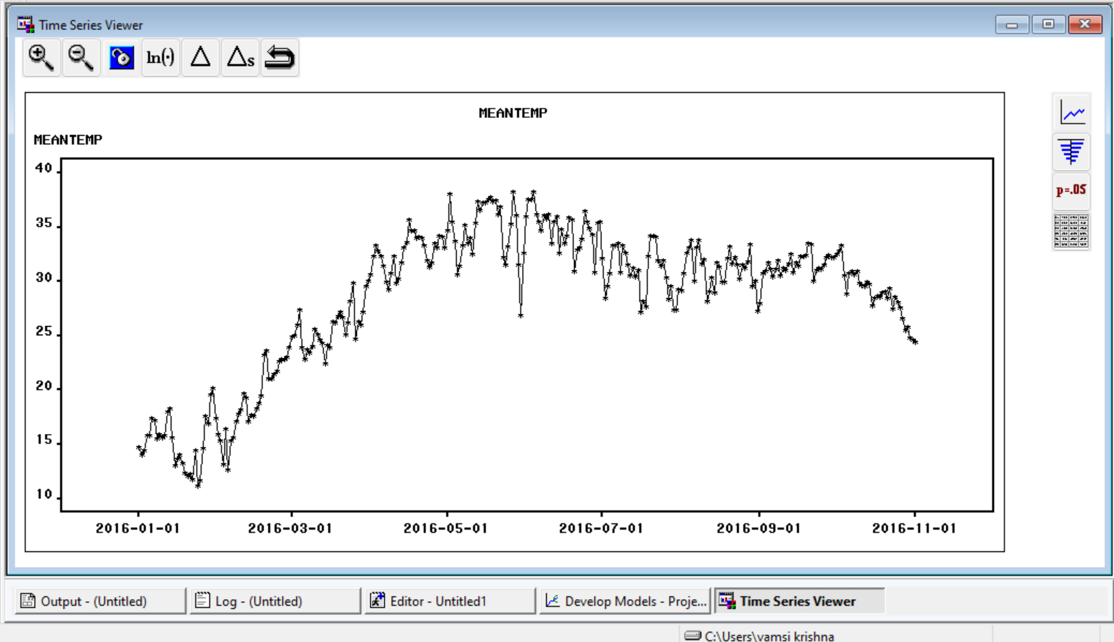
Trend
No particular trend is observed

Slide 20
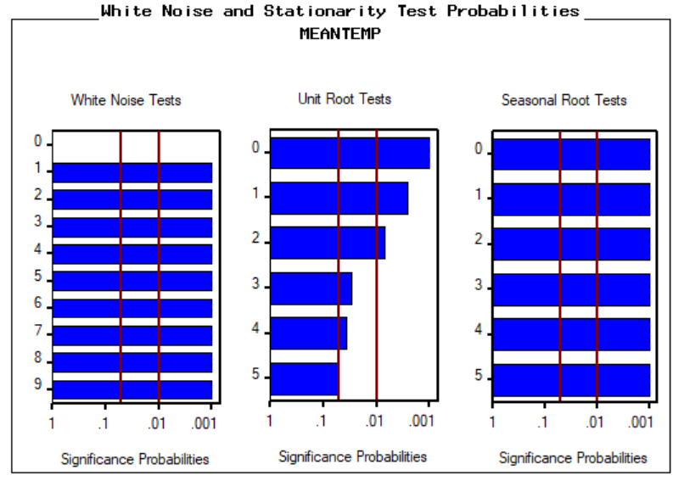
White box test and Unit root test

Slide 21
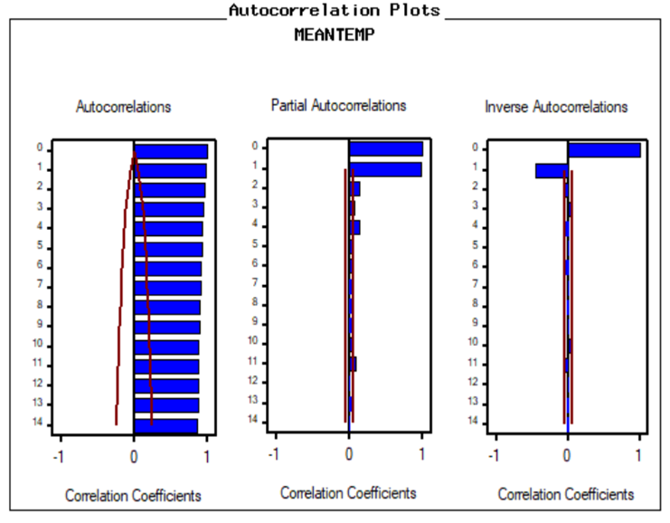
Autocorrelation Plots

Slide 22
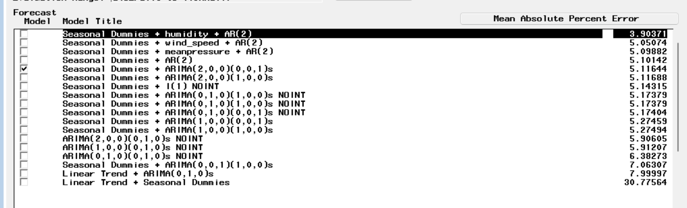
Models developed

Slide 23
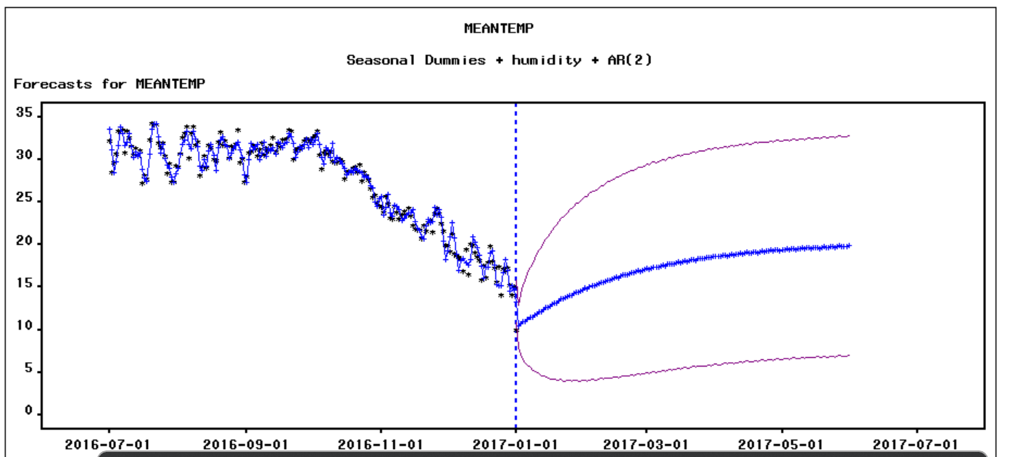
Model Forecast

Slide 24
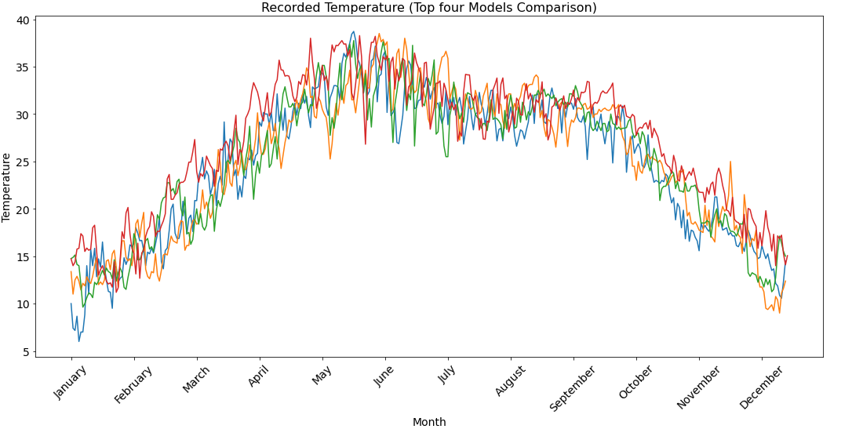
Model Comparison

Slide 25
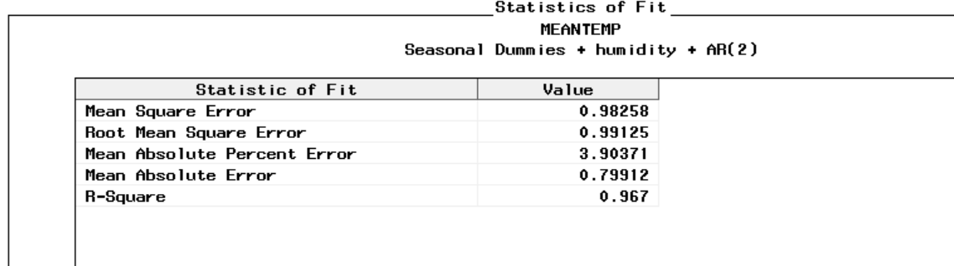
Best Model
AR(2)
Adding Seasonal dummies and regressor gave the best results.

Slide 26
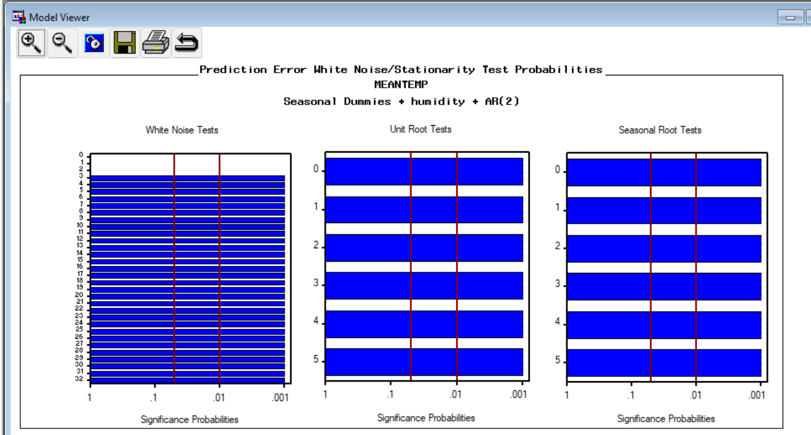
White box Tests

Slide 27
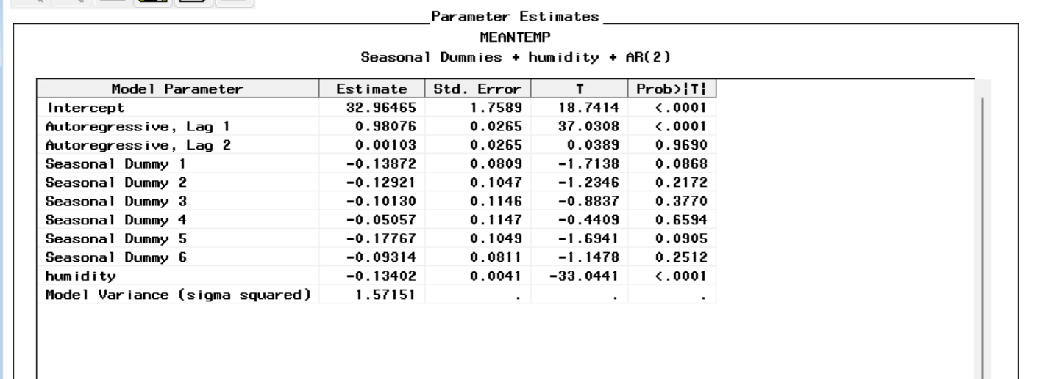
Parameter Estimates for our Best Model

Slide 28
Insights and Recommendations
From the previous data we are able to forecast the temperature levels for the upcoming months , which may be used to guide any necessary precautions.
From the above we can observe that temperature is high during april,May which is summer in delhi.
We also observed that a high temperature automatically increases the likelihood of a high humidity level, which leads to a high wind pressure. This observation can help individuals take precautions to avoid this problem.
During winters there are high chances for fog which results in bad accidents,So to overcome this government could devise creative ideas such as odd-even rule.

Slide 29

Q & A

Slide 30

Thank you
Let’s try our best to save the climate ☺

